Slide 1
Evaluating the Firefighter Optimization Algorithm for Hyperparameter Tuning in CNN-Based Brain Tumor MRI Classification
Graduand: Malak Matar - 2079203 Supervisor: Prof. Luigi Cinque
Applied Computer Science and Artificial Intelligence
Sapienza University of Rome

Slide 2

Table of contents
1|
2|
Introduction & Motivation
Optimization Challenges and Metaheuristics
3|
4|
FFO vs PSO
Dataset, Model Architecture & Experimental Setup
5|
6|
Results
Conclusion and Future Work

Slide 3

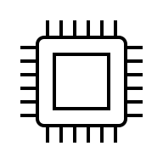
Motivation
Objectives & Novelty
Brain-tumor classification is vital for early diagnosis.
Manual MRI interpretation is slow and subjective.
CNNs can automate detection → need optimal hyperparameters.
Adapt the Firefighter Optimization Algorithm (FFO) for CNN hyperparameter tuning.
Compare its performance against Particle Swarm Optimization (PSO).
Evaluate Performance
AI
Manual Tunning
time-consuming
Automated optimization
efiicient
Notes:
Proteins rarely act alone in the cell – they typically work together in complexes and pathways.Nearly every cellular process, from DNA replication to metabolism, is driven by networks of interacting protein

Slide 4
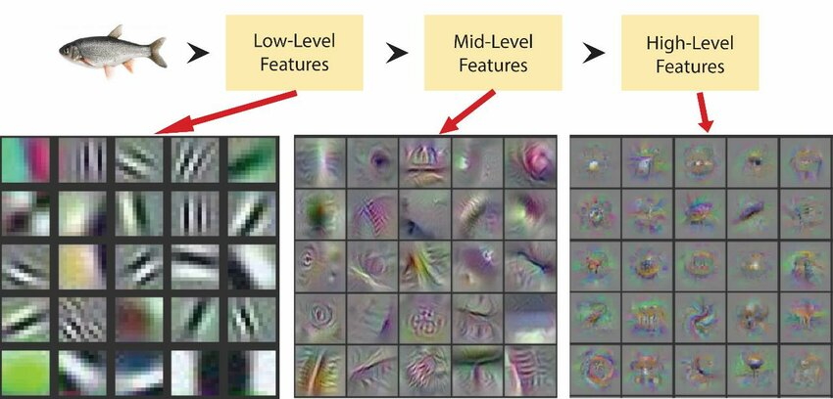
Importance of CNNs in Medical Imaging
Learn hierarchical spatial features directly from images.
Used in MRI, CT, and histopathology
Applications: tumor Detection, segmentation, radiomics
Figure 1: How layers learn data in CNNs
Notes:
Proteins rarely act alone in the cell – they typically work together in complexes and pathways.Nearly every cellular process, from DNA replication to metabolism, is driven by networks of interacting protein

Slide 5
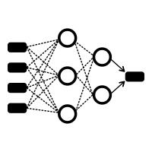




Challenges in CNN Optimization
Training
Many hyperparameters to tune (LR, batch size, dropout …).
Poor choices → over/underfitting.
Grid or manual search → costly.
Need automatic, robust tuning.
Hyperparameters
Performance
Method | Description | Limitation
Manual /Grid | Exhaustive Search | Expensive
Random | Random Sampling | Inefficient and Unreporfucable
Bayesian | Surrogate Model | Poor Scaling
Table 1: Existing Hyperparameter tuning Methods
Notes:
Proteins rarely act alone in the cell – they typically work together in complexes and pathways.Nearly every cellular process, from DNA replication to metabolism, is driven by networks of interacting protein

Slide 6
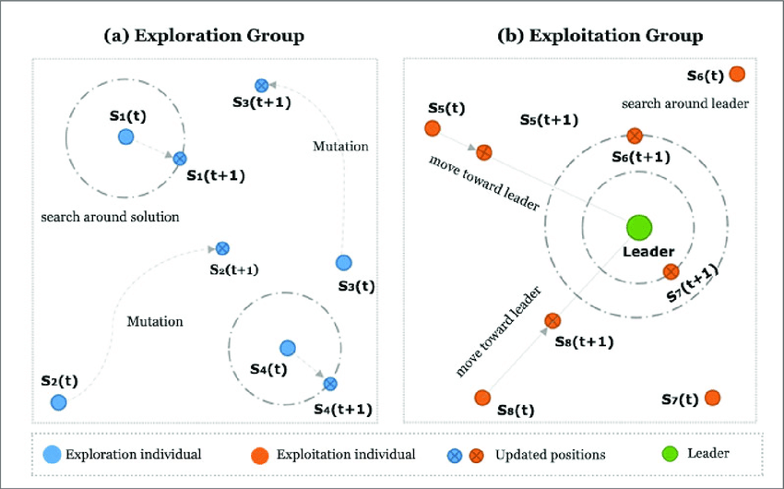
Metaheuristic Optimization Algorithms
What are metaheuristics?
Population-based search strategies inspired by natural processes.
Operate without gradient information — suitable for non-convex problems.
Balance exploration (global search) and exploitation (local refinement).
Common examples: PSO, Genetic Algorithms, Grey Wolf Optimizer, FFO.
Notes:
Proteins rarely act alone in the cell – they typically work together in complexes and pathways.Nearly every cellular process, from DNA replication to metabolism, is driven by networks of interacting protein

Slide 7
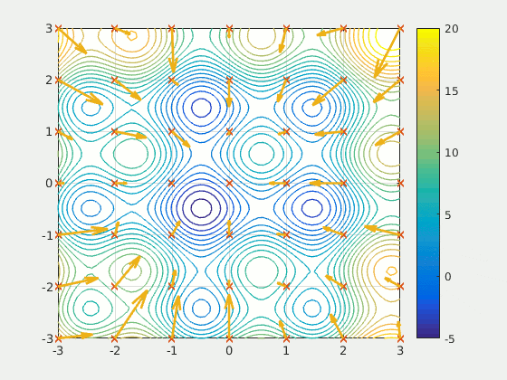
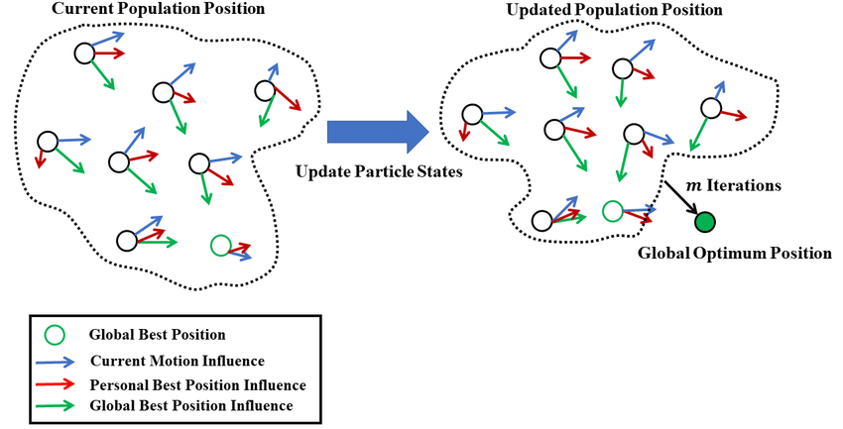
Particle Swarm Optimization
Baseline Algorithm
Population-based stochastic optimizer inspired by social learning.
Each particle explores the search space while sharing information with the swarm.
Balances exploration (diversity) and exploitation (convergence).
Figure 2: Simulation of particle swarm dynamics converging toward the global optimum.
Figure 3: Collective motion of particles toward the global optimum over iterations.

Slide 8
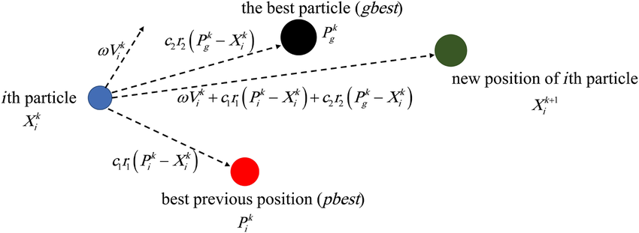
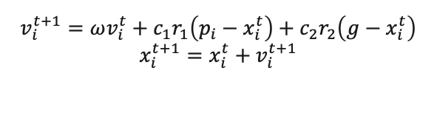
PSO Update Mechanism
Velocity and Position Update
$$v_{i}^{t+1}=ωv_{i}^{t}+c_{1}r_{1}\left(p_{i}−x_{i}^{t}\right)+c_{2}r_{2}\left(g−x_{i}^{t}\right)$$
$$x_{i}^{t+1}=x_{i}^{t}+v_{i}^{t+1}$$
Figure 4: Forces acting on a particle during velocity update (inertia, cognitive, and social components).

Slide 9
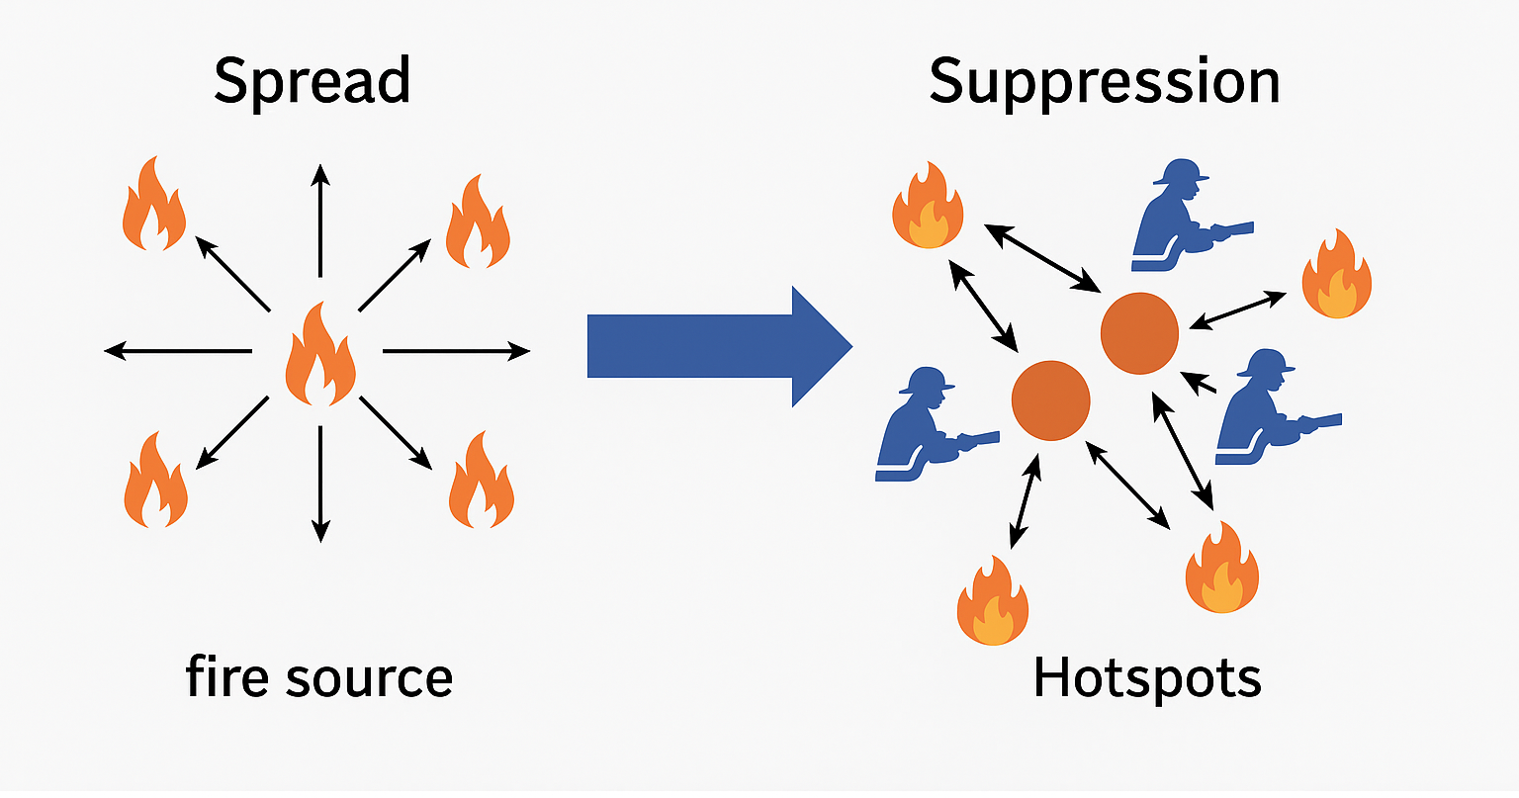
Firefighter Optimization Algorithm
FFO Overview
Population-based metaheuristic inspired by fire spread and firefighting.
Each agent = potential solution ("fire source").
Alternates between:
Spread: exploration to discover new regions.
Suppression: exploitation near promising zones.
Adaptive control parameters (α, β) balance exploration and exploitation.
Figure 5. Spread explores new regions; suppression focuses on promising areas.

Slide 10
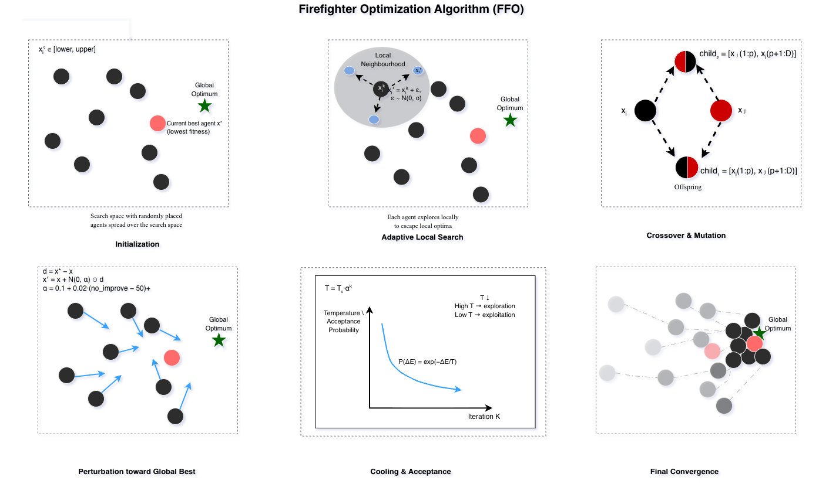


Slide 11
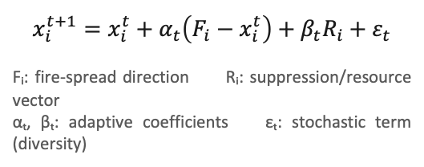
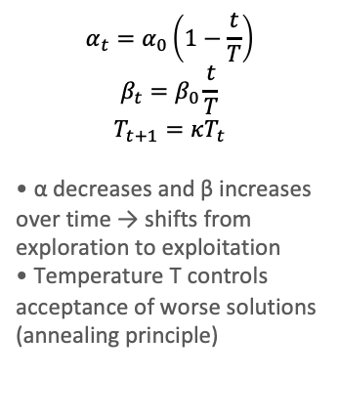
FFO Update Mechanism
Adaptive Position update and Parameter Dynamics
$$x_{i}^{t+1}=x_{i}^{t}+α_{t}\left(F_{i}−x_{i}^{t}\right)+β_{t}R_{i}+ε_{t}$$
Fᵢ: fire-spread direction Rᵢ: suppression/resource vector
αₜ, βₜ: adaptive coefficients εₜ: stochastic term (diversity)
$$α_{t}=α_{0}\left(1−\frac{t}{T}\right)$$
$$β_{t}=β_{0}\frac{t}{T}$$
$$T_{t+1}=κT_{t}$$
• α decreases and β increases over time → shifts from exploration to exploitation
• Temperature T controls acceptance of worse solutions (annealing principle)

Slide 12

Methodology
Dataset
CNN Architecture
Kaggle Brain Tumor MRI Dataset (3264 images, 4 classes).
Train/Val/Test = 70/15/15 with seed logging.
Resized 224×224, normalized [0, 1].
Pre-trained VGG16 base (frozen convolutional layers)
Custom dense head: Dense → Dropout → Softmax (4 classes)
Tunable hyperparameters: dense units, dropout rate, learning rate, batch size, L2 regularization, unfrozen blocks
Glioma tumor sample
Meningioma tumor sample
Pituitary tumor sample
Healthy brain sample
Figure 7: representitve MRI slices from each diagnostic class
Figure 8: VGG16-based CNN architecture with custom classification head

Slide 13
Methodology
Algorithm 1: Firefighter Optimization Algorithm (FFO)
Input: population size N, max iterations T, α₀, β₀, temperature T₀
Output: best solution g
-----------------------------------------------------
1 Initialize population X = {x₁, x₂, …, xₙ} randomly
2 Evaluate fitness f(xᵢ) for all agents
3 Identify global best g = argmin f(xᵢ)
4 for t = 1 to T do
5 for each agent xᵢ in X do
6 Perform adaptive local search around xᵢ
7 Apply crossover and mutation
8 if no improvement then
9 Apply perturbation guided by g
10 end if
11 Update position:
xᵢ ← xᵢ + αₜ(Fᵢ − xᵢ) + βₜRᵢ + εₜ
12 end for
13 Update αₜ, βₜ, and temperature Tₜ
14 end for
15 return g
Optimization Procedure
Optimizers: FFO (proposed) and PSO (baseline)
Equal evaluation budgete
Hyperparameter search space identical for both algorithms
Each trial runs evaluate model over 25% of the dataset (hparams, X_train, X_val)
Evaluation & Reproducibility
Metrics: Accuracy, Precision, Recall, F1-score, AUC
Fixed random seeds → reproducible splits and initialization
Environment: Leonardo HPC cluster (A100 GPU)

Slide 14
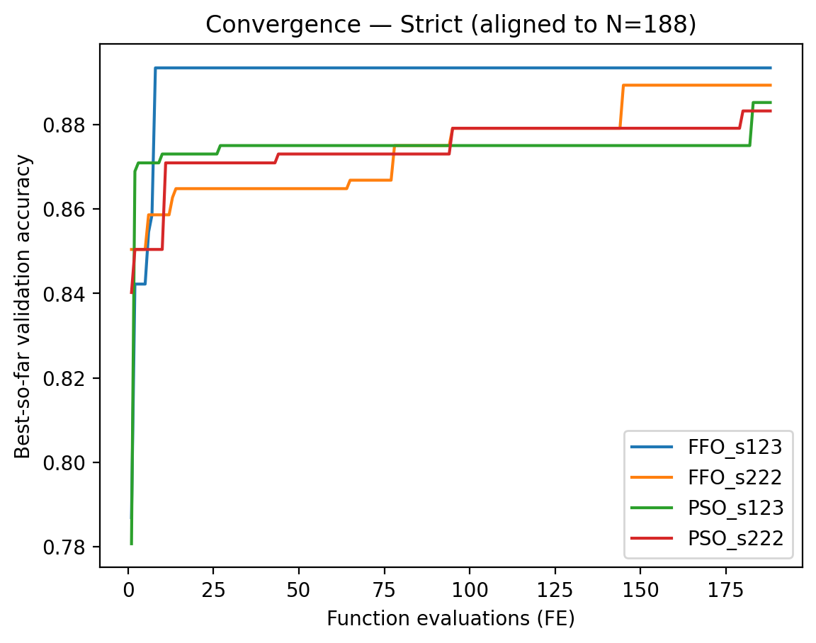
Convergence Behavior of FFO and PSO
Validation accuracy progression across 188 evaluations
FFO achieves faster convergence and higher final accuracy
PSO maintains gradual improvement → smoother exploration
Variance across seeds remains low → stable optimization
Figure 9. Convergence curves of FFO and PSO across aligned evaluation budgets.

Slide 15
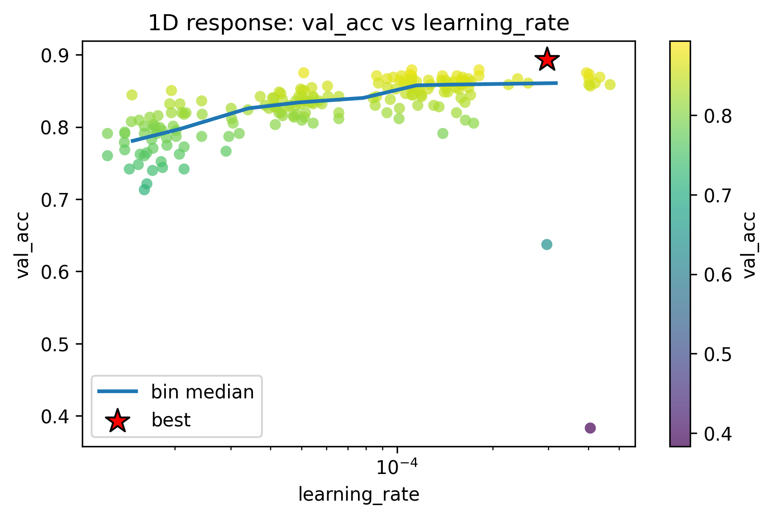
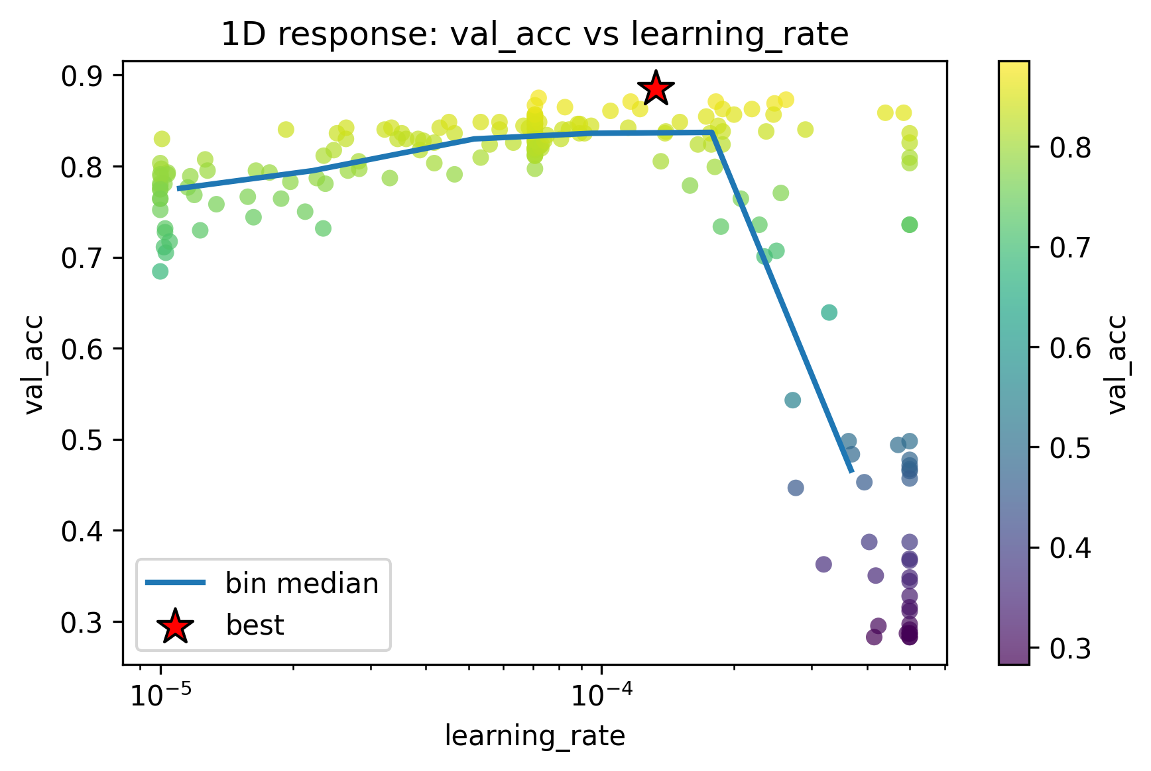
Optimization Trajectories and Hyperparameter Sensitivity
FFO
PSO
Figure 10: FFO (seed 123): one-dimensional response of validation accuracy with respect to learning rate.
Figure 11: PSO (seed 123): one-dimensional response of validation accuracy with respect to learning rate.

Slide 16
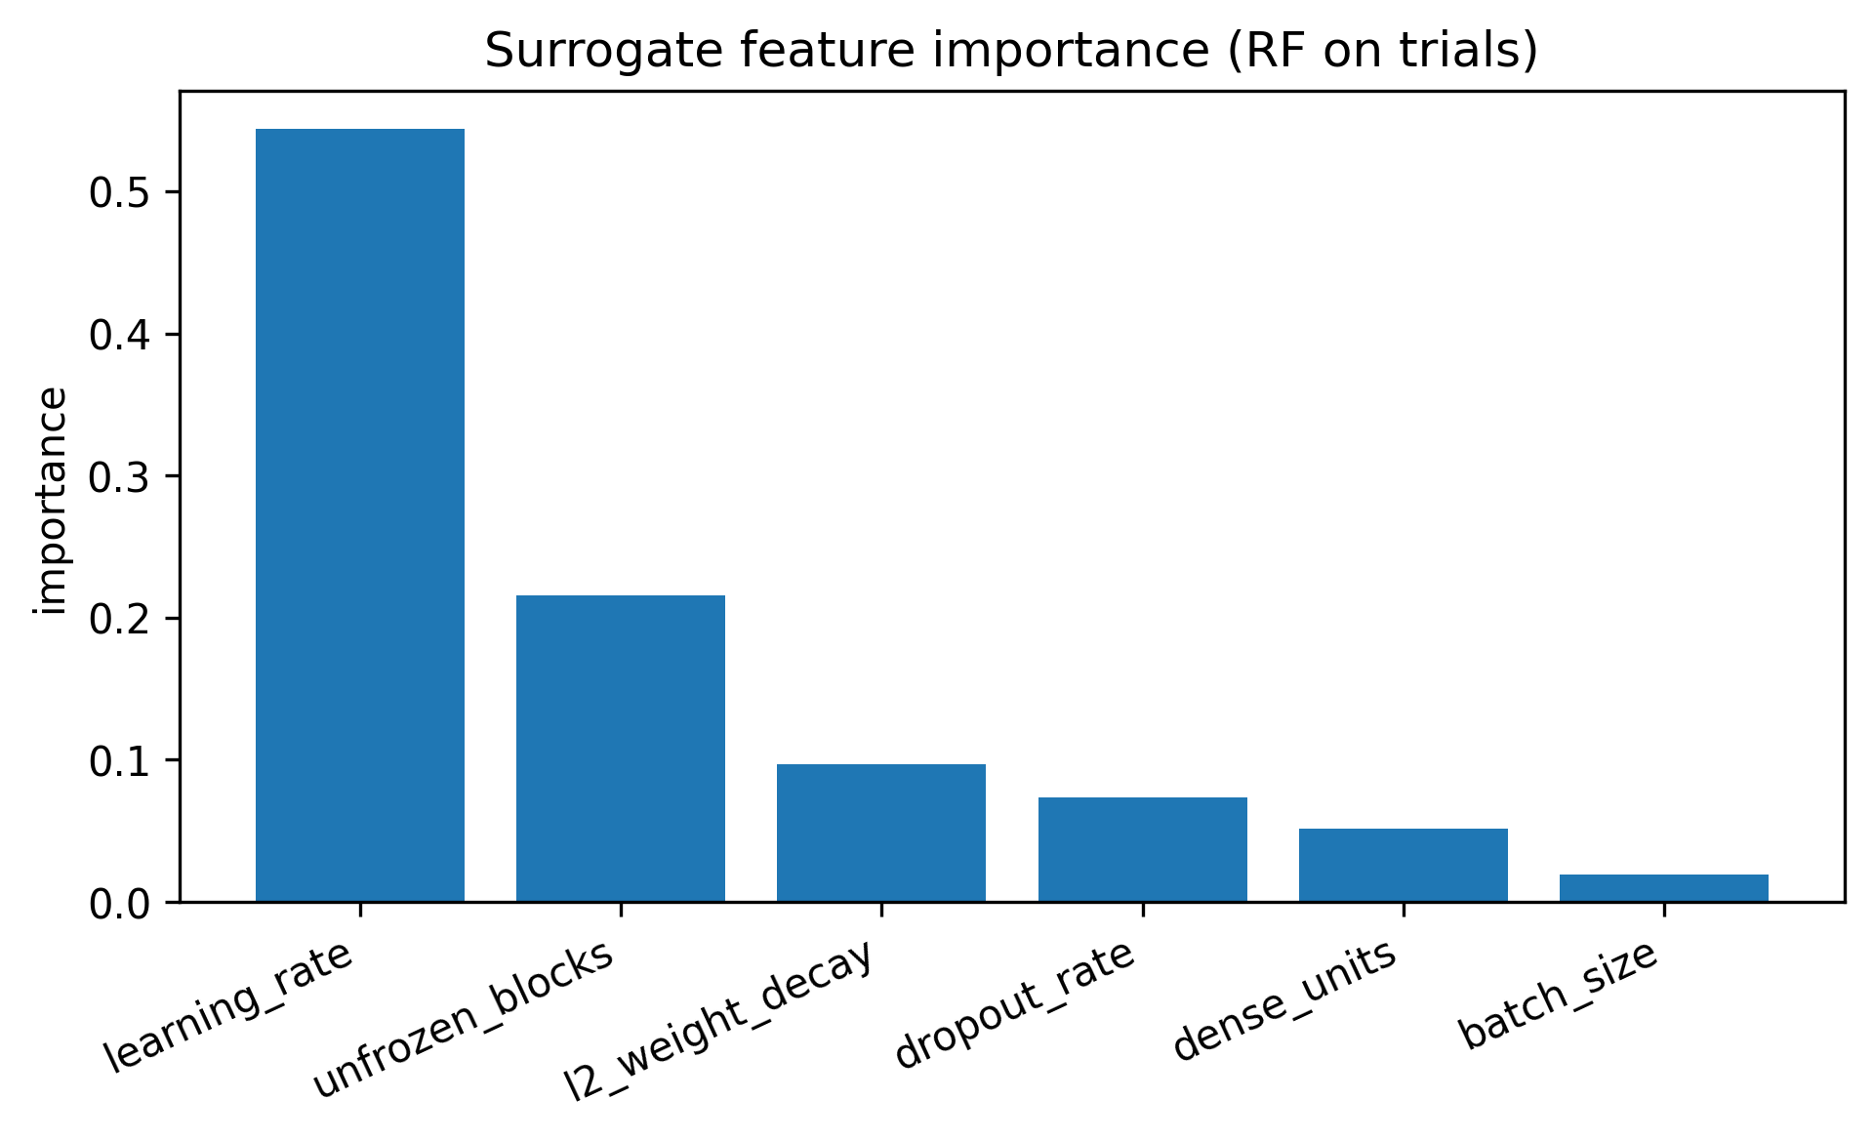
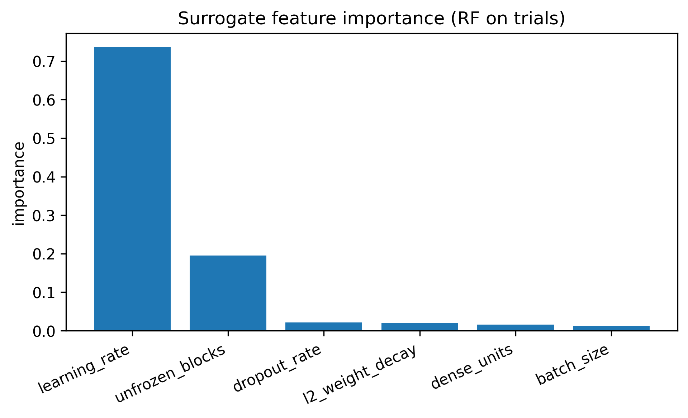
Optimization Trajectories and Hyperparameter Sensitivity
FFO
PSO
Figure 12: FFO (seed 123): relative hyperparameter importance showing influence on validation accuracy.
Figure 13: PSO (seed 123): relative hyperparameter importance showing influence on validation accuracy.

Slide 17
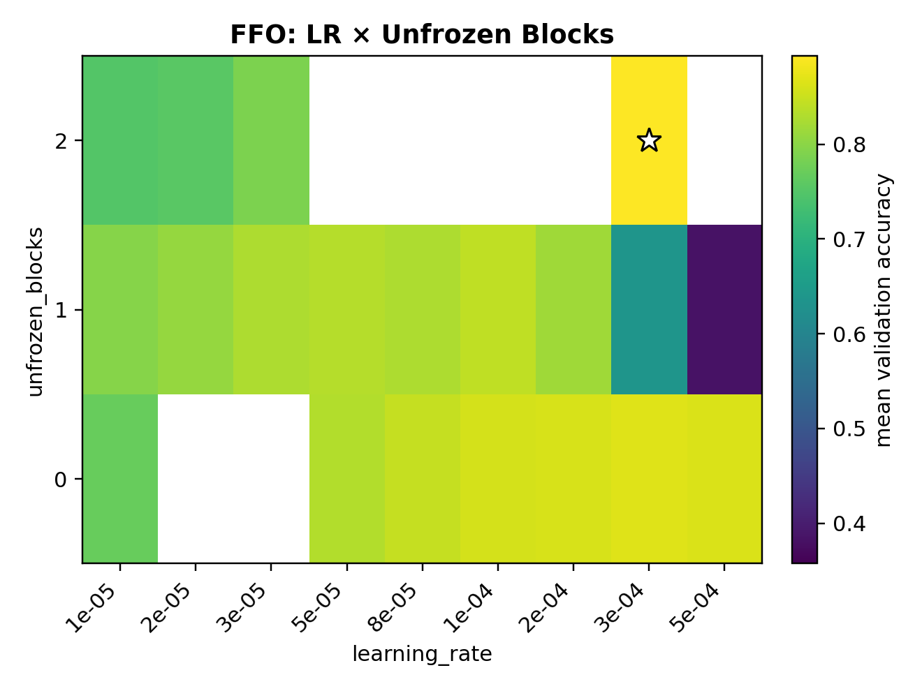
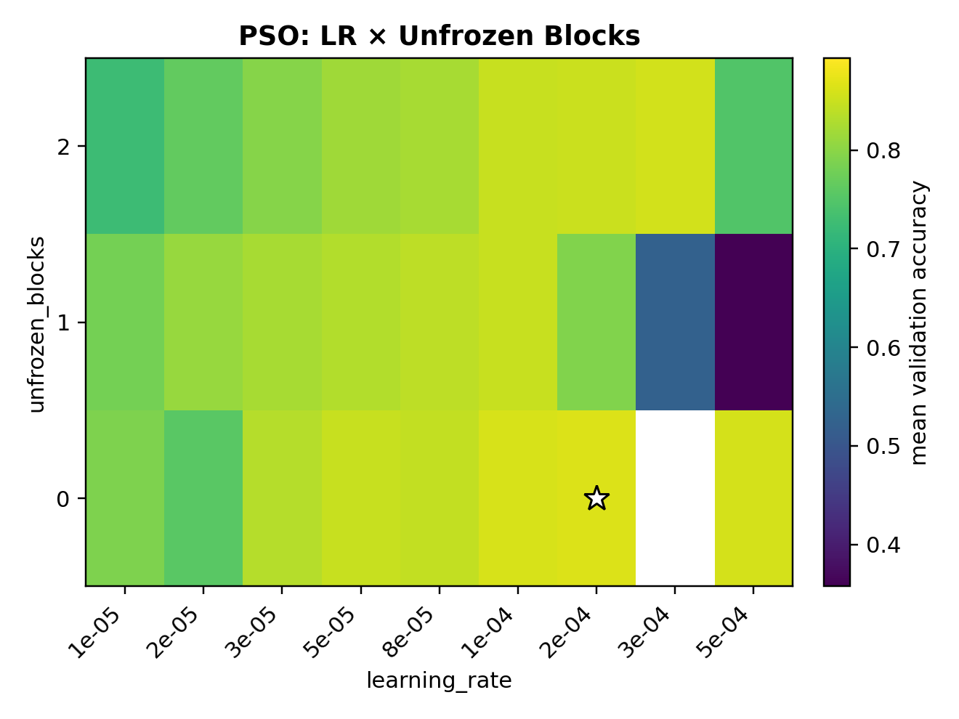
Optimization Trajectories and Hyperparameter Sensitivity
Figure 13: FFO (seed 123): Validation Accuracy Across Learning Rate × Unfrozen Blocks
Figure 14: PSO (seed 123): Validation Accuracy Across Learning Rate × Unfrozen Blocks

Slide 18
Best Hyperparameter Performance on Full Test Set
Figure 15: Confusion matrices showing per-class classification accuracy for each optimizer.

Slide 19
Generalization and Discrimination Capability
Figure 16: ROC and Precision–Recall curves illustrating high discrimination ability across tumor classes.

Slide 20
Aggregate Performance Comparison
Algorithm | Accuracy (%) | Percision | Recall | F1-score
FFO_s123 | 98.58 | 0.985 | 0.986 | 0.985
FFO_s222 | 94.73 | 0.950 | 0.949 | 0.948
PSO_s123 | 95.33 | 0.957 | 0.952 | 0.954
PSO_s222 | 93.91 | 0.944 | 0.942 | 0.942
Figure 17: Summary of test-set performance for each optimizer with best hyperparameters.

Slide 21
Limitations
Computational cost: each evaluation requires full CNN training. Tested on a single dataset — results may vary across domains.
Future Work
Apply FFO to deeper and more modern architectures (ResNet, DenseNet, EfficientNet). Extend to 3D MRI or multimodal medical datasets. Integrate FFO with Bayesian or hybrid metaheuristics. Explore multi-objective optimization (accuracy vs runtime).
Small number of evaluation trials (200) and only 2 random seeds per method was tested restricting statistical robustness.
Only tested on VGG16 so sensitivity to architecture was not examined Only evaluated against PSO
Evaluate hybrid metaheuristics (FFO-PSO, FFO-GWO) for improved convergence.

Slide 22
Thank you for your attention
Questions?

